Slide 1
University of Bahrain
College of Information Technology
Department of Information Systems
ITIS232 LAB – System Analysis and Design I
Semester 1, 2020/2021
Project “Case Study”
Abubaker Gul | 20194401
Abrar Javaid | 20192906
Fahed Ishfaq Ahmed | 20192782
Muneeb Ahmad Riaz | 20192153

Slide 2
FUNCTIONAL REQUIREMENTS:
F1 | Authorized login
Description | This interface allows user to access pharmacy system using their log in credentials.
F2 | Signing up
Description | If the customer has no account, he must sign up using his email address.
F3 | Confirmation/Verification
Description | After entering email, a link would be sent by system to confirm the user account then user can log in using his account
F4 | System Interface
Description | This interface allows employees with authorized access log in credentials. Pharmacy system provides multiple features like manipulation of records, addition, deletion or updating orders.
F5 | Sending Medical prescriptions
Description | The user is required by the system to upload his/her medical prescriptions.
F6 | Entering address
Description | The customer is required to enter address details by finding it on the map.

Slide 3
F7 | Address confirmation
Description | This system allows the customer to confirm their address to avoid any inconvenience or delay in the delivery process
F8 | Specifying whole address
Description | The customer is required to enter the whole address in detail for e.g., city, area, road, block etc.
F9 | Order Details
Description | The system will issues the details of the customer’s order. It’s known as a printed receipt that includes customer’s name, expected delivery time and order details. These details can be viewed by both the customer and the system.
F10 | Personal information
Description | The costumer is required to enter personal and contact information in order to keep him updated about his order.
F11 | Payment method
Description | The customer must pay through his credit card for verifying the customer and in order to authorize his card, an authorization request send to the credit card company”
F12 | Order review and confirmation
Description | The system allows customer to review and confirm his/her medicines after this an email is sent to customer with all order details.

Slide 4
F13 | Payment confirmation
Description | After all the process pharmacist handles customers' orders and calculates the final payment. Then an email is sent to customer with all payment details.
F14 | Delivery man
Description | The delivery man then collects the customer's order from pharmacy and deliver it on scheduled date and time.
F15 | Delivery confirmation
Description | The delivery man then confirms the pharmacy that order has been delivered to the costumer.

Slide 5
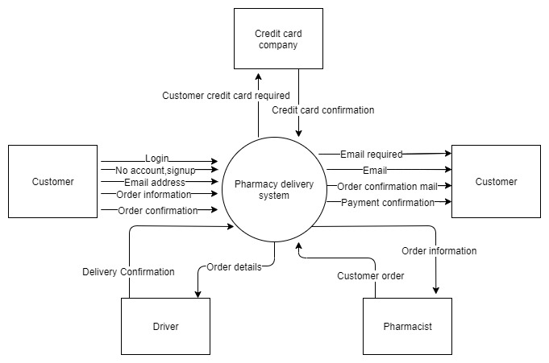
Context level

Slide 6
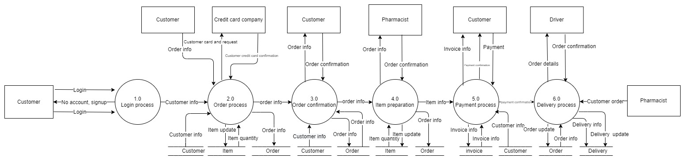
LEVEL 0 DFD

Slide 7
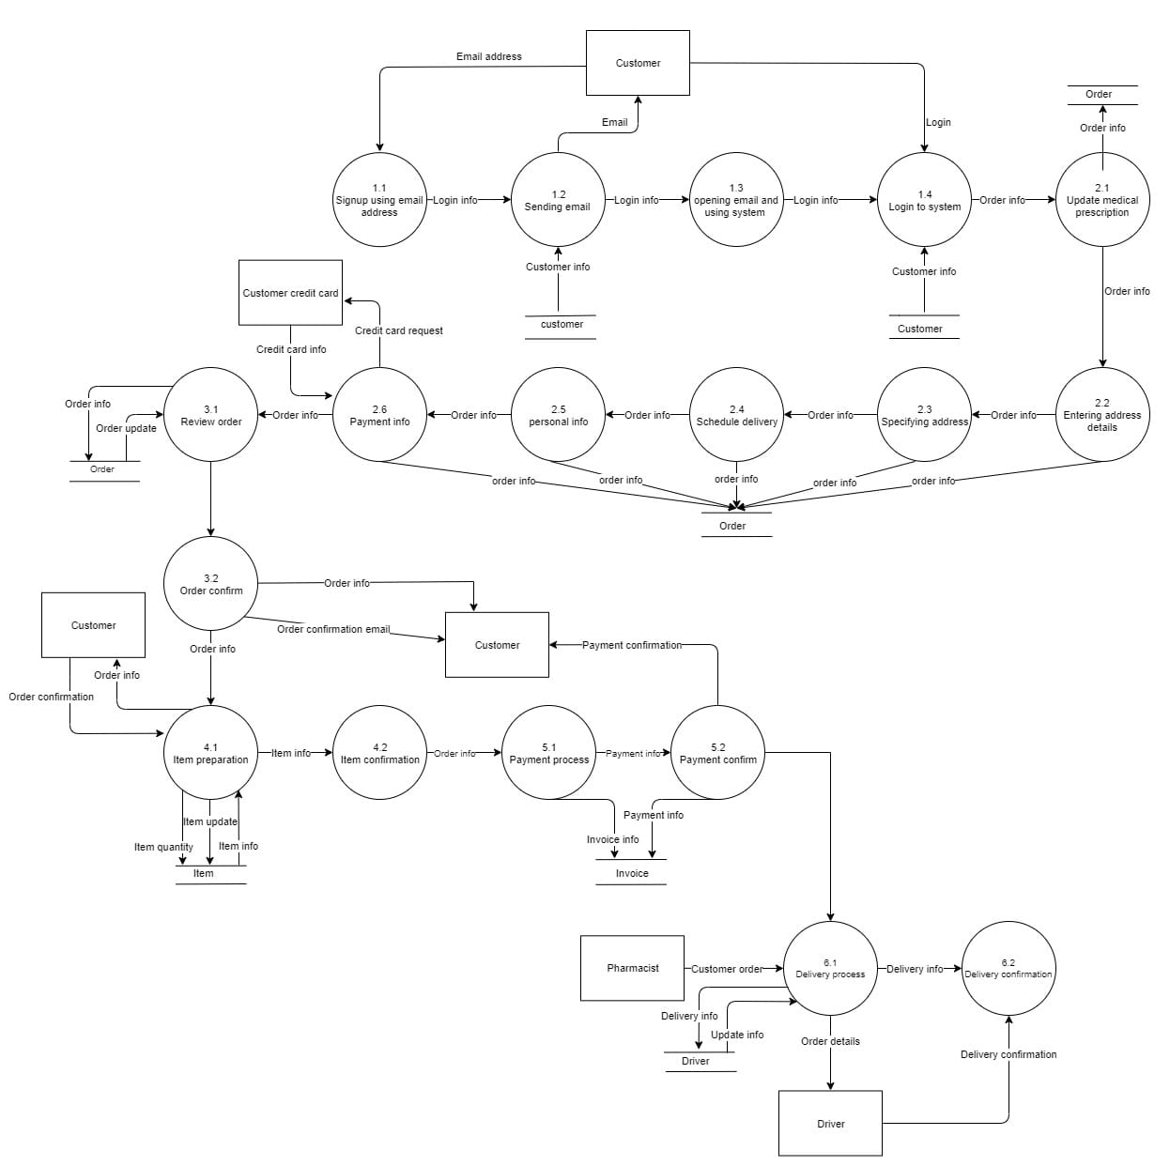
Level 1 DFD

Slide 8
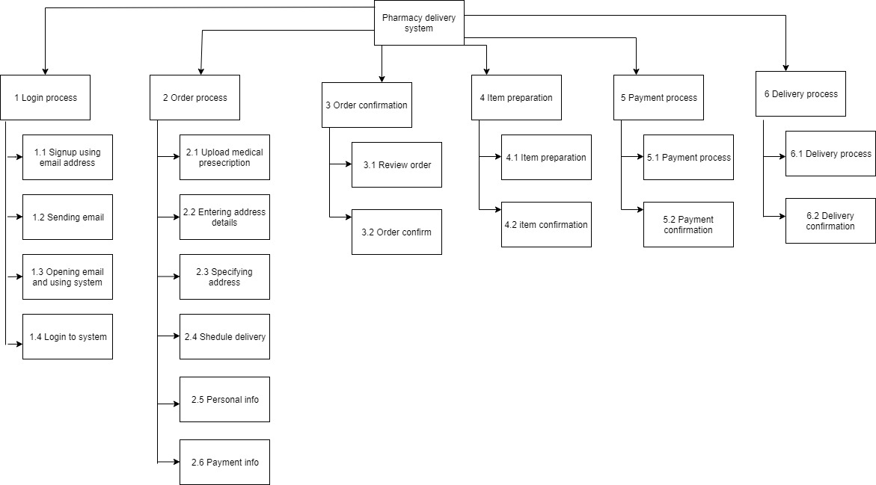
Decomposition diagram

Slide 9
Process Specification
Process ID | 1.1
Process Name | Signing up using email.
Process Description | Get the customers email address from the customer
Input Data Flow | Email address from customer external entity
Output Data Flow | Login information to process 1.2
logic
Remarks

Slide 10
Process ID | 1.2
Process Name | Sending email
Process Description | Sending email for notifying the customer
Input data flow | Log in information from process 1.1 Customer information from customer data store.
Output data flow | Log in information to process 1.3 Email to customer external entity.
logic | Check if the customer has sign up using email address. Then go to process 1.3 else notify the customer to sign up using email address.
Remarks

Slide 11
Process ID | 1.3
Process Name | Opening email and using system.
Process Description | Customers will open the email to use the system.
Input data flow | Log in information from process 1.2
Output data flow | Log in information to process 1.4
logic
Remarks

Slide 12
Process ID | 1.4
Process Name | Log into the system
Process Description | Customer will login and use the system.
Input data flow | Log in information from process 1.3 Customer information from customer data store . Log in from customer external entity.
Output data flow | Customer information to process 2.1
logic | Check if the customer has account Then go to process 2.1 else Go to process 1.1
Remarks

Slide 13
Process ID | 2.1
Process Name | Upload medical prescription
Process Description | Customer will upload his medical prescription to place order
Input data flow | Customer information from process 1.4
Output data flow | Order information to process 2.2 Order information to order record
logic
Remarks

Slide 14
Process ID | 2.2
Process Name | Entering address details
Process Description | Customer will enter his address to receive the order.
Input data flow | Order information from process 2.1
Output data flow | Order information from 2.3 Order information to order record .
logic
Remarks

Slide 15
Process ID | 2.3
Process Name | Specifying address.
Process Description | Customer will specify his address to receive the order.
Input data flow | Order information from process 2.2
Output data flow | Order information to process 2.4 Oder information to order record.
logic
Remarks

Slide 16
Process ID | 2.4
Process Name | Schedule delivery.
Process Description | Customer will schedule delivery to receive the order
Input data flow | Order information from process 2.3
Output data flow | Order information to process 2.5 Order information to order record
logic
Remarks

Slide 17
Process ID | 2.5
Process Name | Personal information
Process Description | Get the customer personal information to place the order
Input data flow | Order information from process 2.4
Output data flow | Order information to process 2.6 Order information to order record
logic
Remarks

Slide 18
Process ID | 2.6
Process Name | Payment information.
Process Description | Entering payment information for payment.
Input data flow | Order information from process 2.5 Customer credit card information from customer credit card Company external entity.
Output data flow | Customer credit card request to customer credit card. Company external entity. Order information to process 3.1 Order information to order record.
logic
Remarks

Slide 19
Process ID | 3.1
Process Name | Review order details
Process Description | Customer will review the order before confirmation.
Input data flow | Order information from process 2.6 Order update from order record.
Output data flow | Order information to process 3.2 Order information to order record.
logic
Remarks

Slide 20
Process ID | 3.2
Process Name | Order confirmation
Process Description | Determining the order is accepted or rejected by customer.
Input data flow | Order information from process 3.1
Output data flow | Order confirmation email will be sent to customer external entity. order information to process 4.1 Order information to order record.
logic | Check if the order is confirmed. Then go to process 4.1 Else notify the customer.
Remarks

Slide 21
Process ID | 4.1
Process Name | Item preparation
Process Description | Pharmacist will prepare item for the customer.
Input data flow | Order information from process 3.2 Order confirmation pharmacist from external entity
Output data flow | Order information to external entity pharmacist Item quantity to item record Item update to item record Item information to process 4.2
logic | Check if the item is available with pharmacist Then go to process 4.2 Else send item update to the item record.
Remarks

Slide 22
Process ID | 4.2
Process Name | Item confirmation
Process Description | Determining the item is available or not.
Input data flow | Item information from process to 4.1 Item information from item record
Output data flow | Order information to process 5.1
logic
Remarks

Slide 23
Process ID | 5.1
Process Name | Payment process
Process Description | Generating an invoice for the customer order.
Input data flow | Order information from process to 4.2
Output data flow | Invoice information to invoice record. Payment information to process 5.2
logic
Remarks

Slide 24
Process ID | 5.2
Process Name | Payment confirmation
Process Description | Sending payment confirmation to customer
Input data flow | Payment information from process 5.1
Output data flow | Payment confirmation to customer external entity Payment update to invoice record.
logic | Check if the payment is confirmed Then go to process 6.1 Else notify the customer
Remarks

Slide 25
Process ID | 6.1
Process Name | Delivery process
Process Description | The finished order is packed and labelled for delivery
Input data flow | Order information from process to 5.2 Customer order from pharmacist external entity Update information from driver record.
Output data flow | Order details to driver external entity Delivery information to driver record. Delivery information to process 6.2
logic
Remarks

Slide 26
Process ID | 6.2
Process Name | Delivery confirmation
Process Description | Confirming that order has being delivered.
Input data flow | Order information from process to 6.1 Delivery confirmation from driver external entity
Output data flow
logic
Remarks

Slide 27
Decision Table:
Verify Customer Order:
SCENARIO:
Online pharmacy system wants to create a decision table to verify the customer order process . In order to confirm the order submission to the system the driver must follow the 3 conditions. Order availability in pharmacy, order delivered to the customer and delivered according to the schedule.
The actions taken during this process are accepted or rejected. If the 3 conditions are met the order will be accepted and the order will be rejected if any of the condition is not met.
CONDITIONS:
C1: order availability (Y, N)
C2: order delivered (Y, N)
C3: order deliver according to the schedule (Y, N)
NUMBER OF RULES:
2*2*2 = 8
ACTIONS:
A1: Confirm the order submission to the system
A2: Failed in order submission to the system

Slide 28
DECISION TABLE:
C1 : Order availability (Y, N) | Y | Y | Y | Y | N | N | N | N
C2 : Order delivered (Y,N) | Y | Y | N | N | Y | Y | N | N
C3: Order deliver according to the schedule (Y,N) | Y | N | Y | N | N | Y | Y | N
A1 : Confirm the order submission to the system | X
A2 : Failed in order submission to the system |  | X | X | X | X | X | X | X

Slide 29
Data Dictionary:
Pharmacist = Pharmacist ID + Pharmacist name + Gender + {Telephone} + Salary
Customer = CustomerID + Name + {address} + {phone} +Email
Order = Order ID + Customer ID + Item ID + Pharmacist ID + Bill NO + Order date + (Credit card info.) + Payment method
Pharmacist ID | Pharmacist name | Gender | Telephone | Salary
2017 | Abubaker | Male | 37850100/39861098 | 1000 BD
2018 | Abrar | Male | 38125406 | 850BD
CustomerID | Name | address | phone | email
2019 | Fahed | House 513 , Road 1327, Block 213, Muharraq | 3900000 | XYZ@gmail.com
2987 | Muneeb | House 856 , Road 1528, Block 279, Hidd | 3800000 | xyz@gmail.com
Order ID | Customer ID | Item ID | Pharmacist ID | Bill NO | Order date | (Credit card info.) | Payment method
2021 | 2019 | 2092 | 2017 | 10497 | 22/6/2022 |  | cash
2020 | 2987 | 2091 | 2018 | 10498 | 22/4/2021 |  | cash

Slide 30
Data Dictionary:
Inventory = ItemID + Item Name + Price + Item Quantity
Invoice = InvoiceNO + CustomerID + name + ItemID + Item Name + Item Quantity + Price + Total
Delivery= Delivery ID+ CustomerID+ ItemID + Bill NO + Address
ItemID | Item Name | Item Price | Item Quantity
2092 | Panadol 250mg | 2.000 BD | 5
2091 | Brufen 500mg | 3.500BD | 3
InvoiceNO | CustomerID | Name | ItemID | Item Name | Item Quantity | Price | Total
2019876 | 2019 | Fahed | 2092 | Panadol 250mg | 5 | 2.000 BD | 10.000 BD
2019878 | 2987 | Muneeb | 2091 | Brufen 500mg | 3 | 3.500 BD | 10.500 BD
Delivery ID | CustomerID | ItemID | Bill NO | Address
10029 | 2019 | 2092 | 10497 | House 513 , Road 1327, Block 213, Muharraq
10078 | 2987 | 2091 | 10498 | House 856 , Road 1528, Block 279, Hidd

